Slide 1


Slide 2
Academy of General Dentistry
What is the AGD?
How does it benefit me as a Student?
How will it benefit me as a practicing dentist?

Slide 3
What is the AGD?
The Academy of General Dentistry (AGD) is the only organization exclusively dedicated to serving the needs and interests of the general dentist. Founded in 1952, the AGD has grown to become the world's second largest dental association.

Slide 4
Logging on to the
AGD website
www.agd.org
Username: Member ID
Password: Your birthdate (should be entered in as 8 digits, no slashes or dashes – Example: DDMMYYYY)

Slide 5
Subtopics of the FAGD, MAGD
16 Subtopics
Implants
Endodontics
Practice Management
Electives
Removable Prosthodontics
Fixed Prosthodontics and Lab Relations
Oral Medicine/ Oral Diagnosis
Occlusion

Slide 6
Subtopics of the FAGD, MAGD (con’t)
Basic Science
Pediatric Dentistry
Operative
Cosmetic Dentistry
Surgery
Special Patient Care
Periodontics
Orthodontics

Slide 7
Getting Credit for CE
CE Lecturers and programs will apply for CERP and/or PACE approval on running basis
  Acts as stamp of approval so attendees know they will get credit and that the content is from a valid, reviewed source

Slide 8

Getting Credit for CE
ADA - CERP
CERP = Continuing Education Recognition Program
Goes Towards Licensure Maintenance with State Boards of Dentistry

Slide 9
Getting Credit for CE
AGD - PACE
PACE = Program Approval for Continuing Education
Credit Towards AGD Awards:
  Fellowship (FAGD)
  Mastership (MAGD)

Slide 10
AGD-ADA Agreement
AGD will accept CERP (ADA) credits towards Fellowship and Mastership Awards
PACE (AGD) Credits will count towards Licensure Maintenance with the State Board of Dentistry
If you take a CERP or PACE Approved course, it will count towards your FAGD or MAGD award

Slide 11
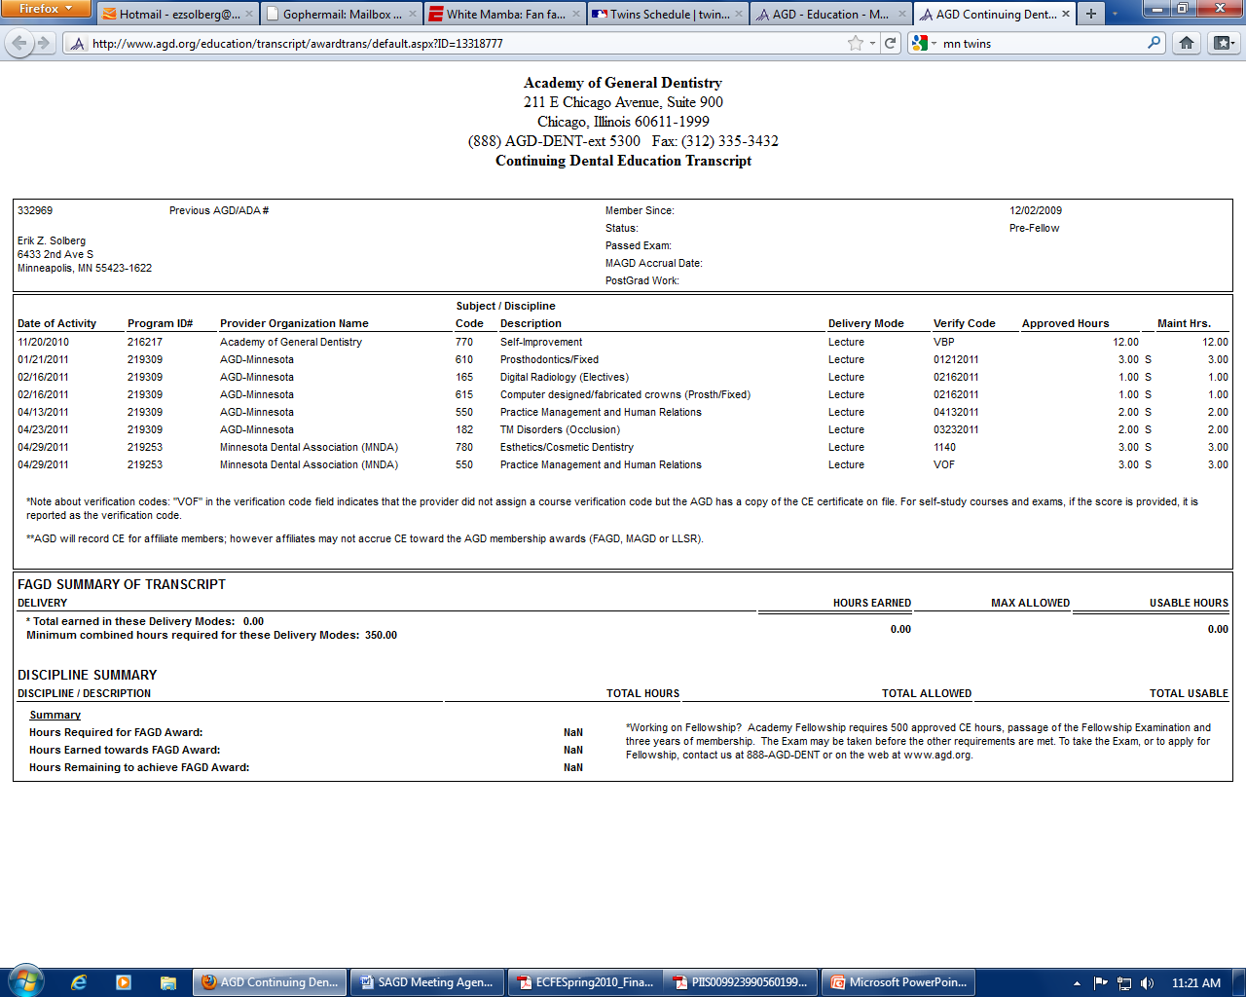

Slide 12
Questions?
Call AGD National Headquarters at 888-243-3368
Email AGD National Headquarters at membership@agd.org
Thank you!

